Slide 1
BOOKIFY
A Unified Platform for Seamless Service Bookings

Slide 2
TABLE OF CONTENTS
01
02
03
04
05
06
INTRODUCTION
PROBLEM & SOLUTION
USECASES
TECHNOLOGY USED
3 – TIER ARCHITECTURE
GRASP / GOF PATTERNS
07
UI DESIGN

Slide 3
INTRODUCTION
Bookify is a comprehensive booking management system designed to simplify and unify the process of booking services like hotels and restaurants through a single, user-friendly platform. It eliminates the hassle of managing multiple apps by offering an integrated solution, enhancing convenience and efficiency for users.

Slide 4
PROBLEMS AND SOLUTION
PROBLEMS
SOLUTIONS
Existing platforms focus on specific services.
Users need multiple apps for bookings.
Unified platform for various bookings.
Simplified, user-friendly experience.

Slide 5
TECHNOLOGY USED
FRONTEND : JAVAFX
BACKEND : JAVA
The user interface is built using JavaFX, providing a rich and interactive client-side experience.
The backend logic is implemented in Java, ensuring robust and scalable server-side functionality.
DATABASE : MYSQL
MySQL serves as the primary database, and a factory pattern is used to support easy integration with other databases in the future

Slide 6
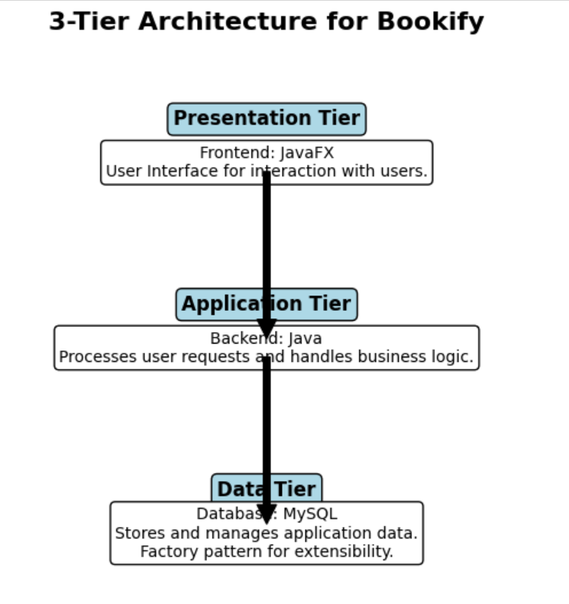
3 – TIER ARCHITECTURE
PRESENTATION TIER (JavaFX)
The user interface is built using JavaFX, providing a rich and interactive client-side experience.
APPLICATION TIER (Java)
The backend logic is implemented in Java, ensuring robust and scalable server-side functionality.
DATA TIER (MySQL)
MySQL serves as the primary database, and a factory pattern is used to support easy integration with other databases in the future

Slide 7
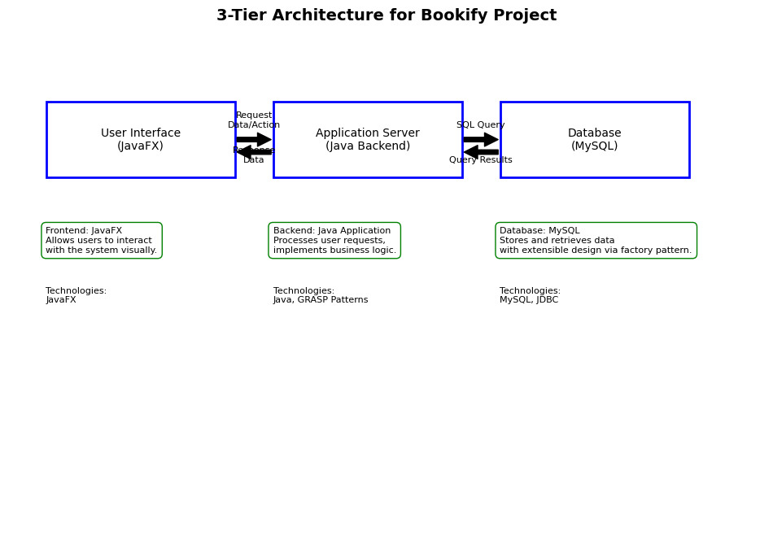

Slide 8

GRASP / GOF PATTERNS
Controller
Low Coupling
The controller oversees the overall flow and design of the application.
Classes are designed to operate independently, minimizing dependencies to ensure flexibility.
High Cohesion
Protected Variation
Each class in Bookify focuses solely on its own specific functionality.
Safeguards against changes in external conditions by isolating key variations.
Pure Fabrication
Factory
The NotificationHandler centralizes notifications, ensuring low coupling and reusability for tasks like booking confirmations.
Simplifies database attachment by using a factory to support diverse systems.

Slide 9
USECASES
View Booking
Manage Service Approvals and Modifications
Make Payment
Purchase Membership and Avail Exclusive Offers
Customer Support
Register User
Targeted Offers
Browse Services
Book a Service
Service Availability Notifications
View Service Analytics
Modify Booking

Slide 10
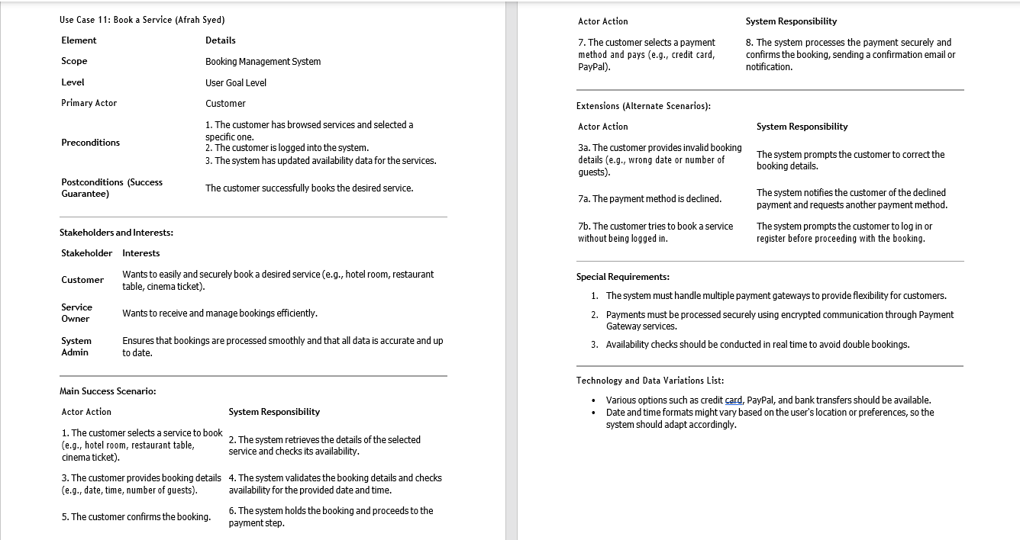
MAJOR USE CASE (Make Booking)

Slide 11
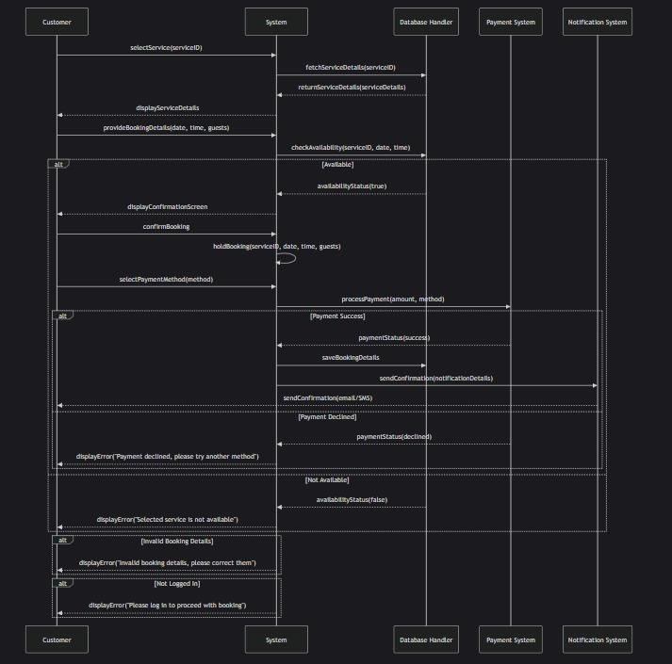

Slide 12
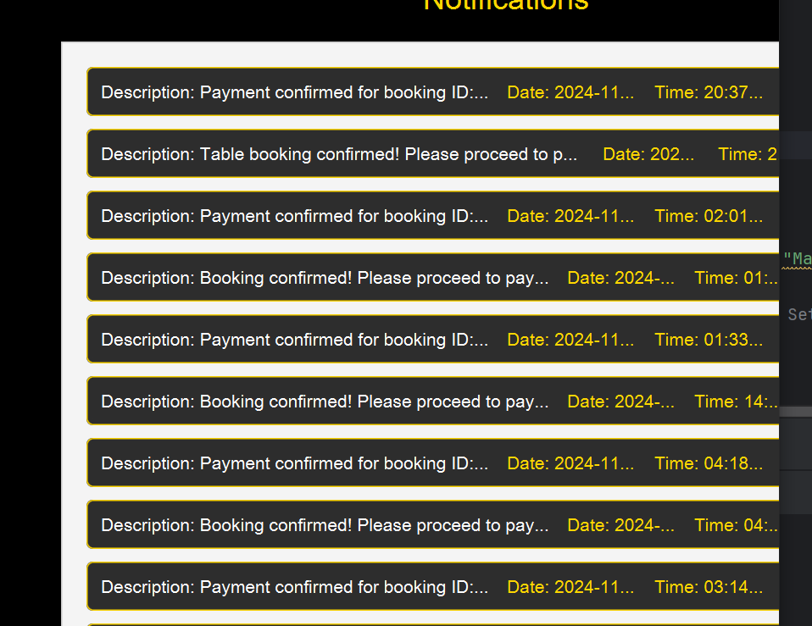
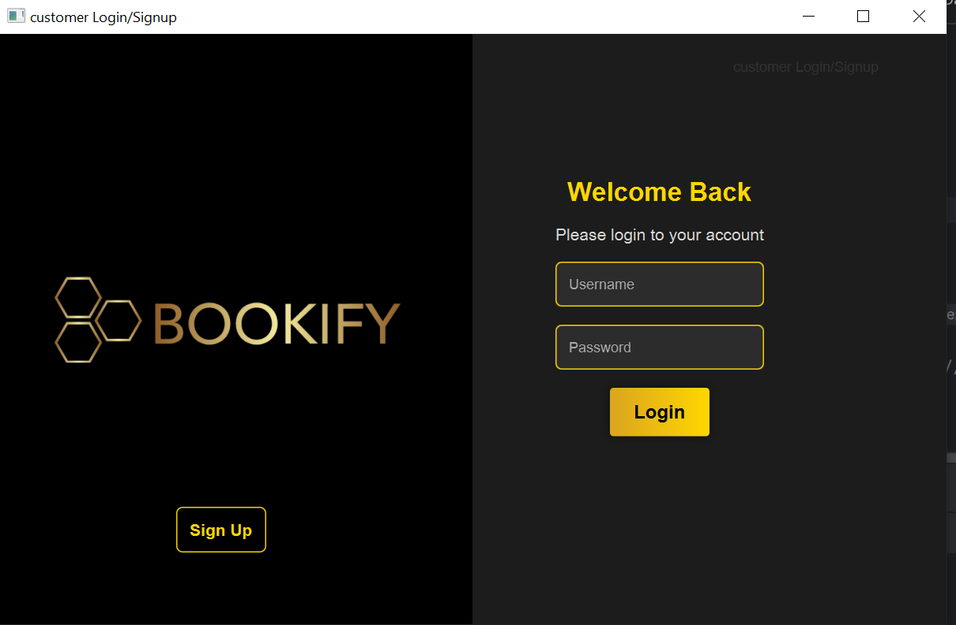
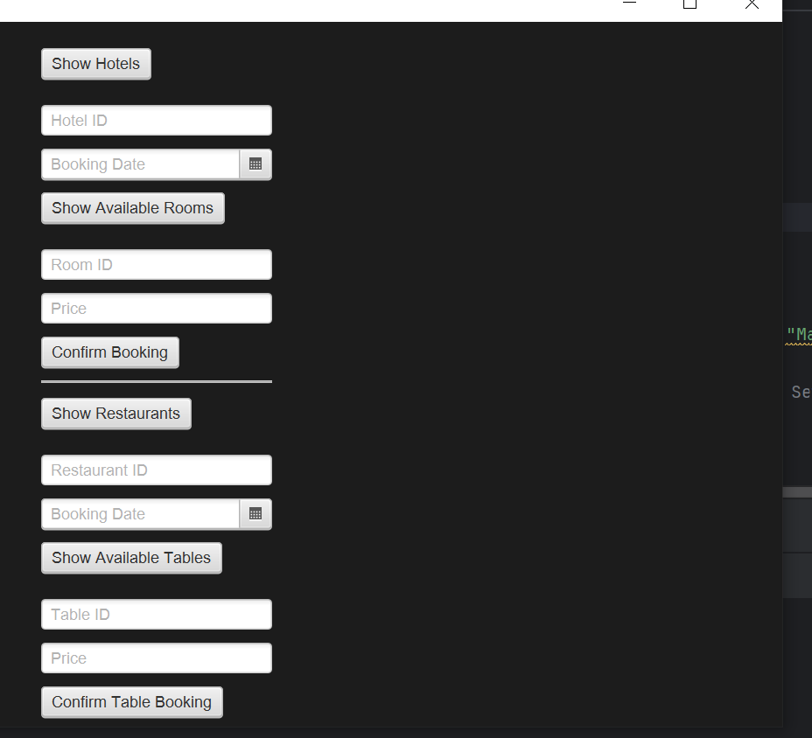
User Interface

Slide 13
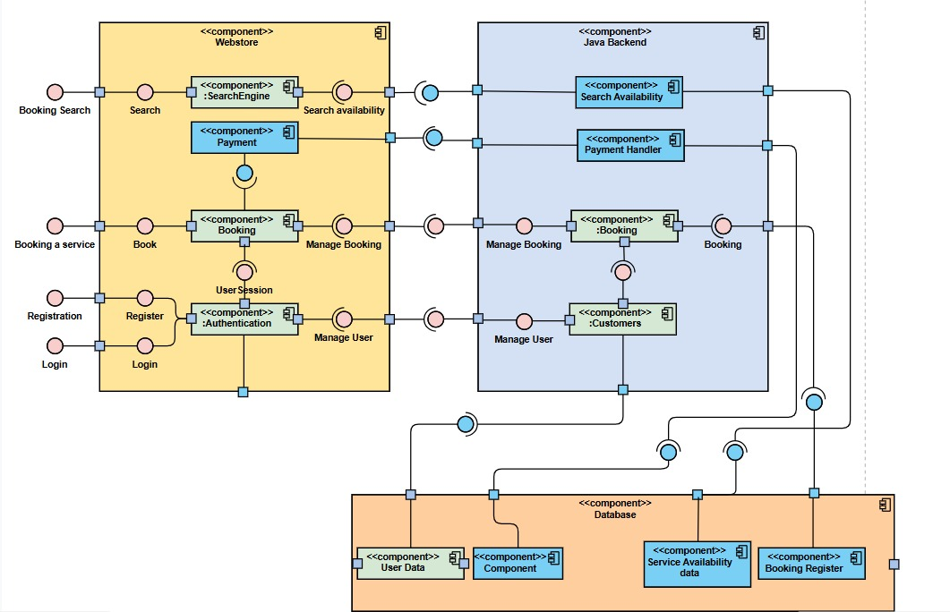
COMPONENT DIAGRAM

Slide 14
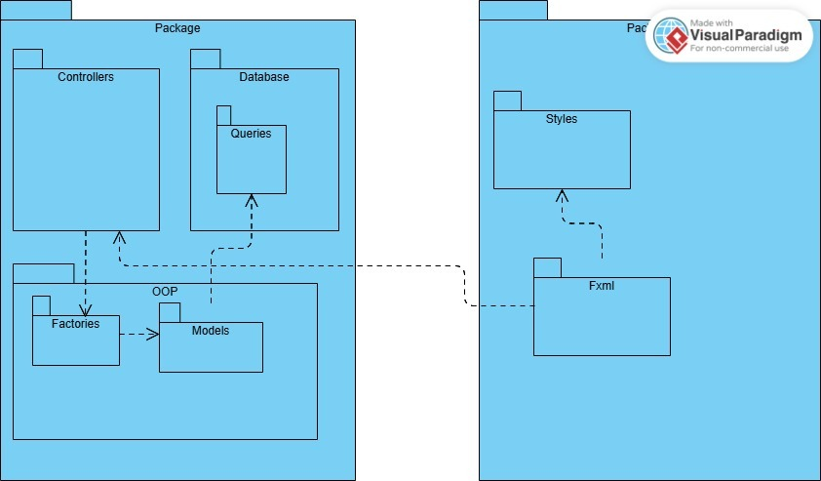
PACKAGE DIAGRAM

Slide 15
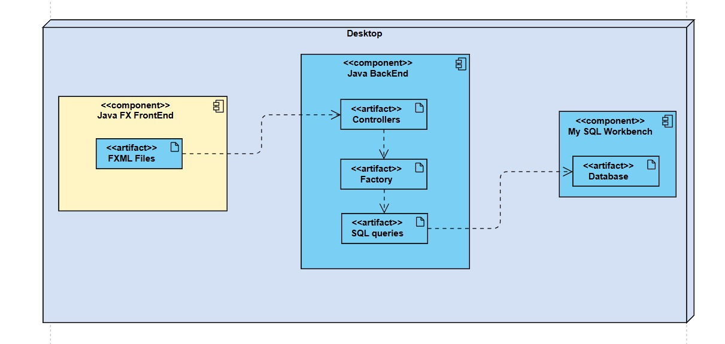
DEPLOYMENT DIAGRAM

Slide 16
THANKYOU

